Slide 1

Microsoft makes movies!
How to kickstart Microsoft’s entry into the streaming movie business
Notes:
Hi, today I’ll be explaining my analysis on how to help Microsoft enter the streaming movie business, something they don’t know anything about

Slide 2
Outline
Business Problem
Data
Questions for Investigation
Results
Conclusions
Notes:
I’ll summarazie the business problem Microsoft faces, explain where I got my data, state the questions I investigated, and then share my results and conclusions

Slide 3


Business problem
microsoft wants to launch a streaming video service with original content
But they don’t know anything about making movies
Notes:
Microsoft sees all the big tech companies (Amazon, Netflix, Hulu) making lots of money from their streaming video services, and luring viewers with original content movies
So Microsoft wants to streaming service and create original content movies too! But they’ve never made movies before and don’t know how to make popular, highly rated movies
So they’re asked for my help

Slide 4

data
Analysis of over 50,000 movies from imdB, THE INTERNET MOVIE DATABASE
Movies are rated by visitors to the site on a scale of 1-10
The measure of a successful movie is its popularity, the movie’s average rating times the number of people who rated it
:
Notes:
To help Microsoft figure out what kind of movies to make, I analyzed over 50,000 from IMDb. IMDb has lots of info about movies, such as the movie’s genre, and names of the cast and crew. IMDb also allows visitors to rate movies, and so has ratings on a scale of 1-10 from real people. Some movies have tens of thousands of ratings, while others only have a few. For this analysis, I’ll look at popularity, defined as the product of a movie’s average rating and the number of users who rated it – so this takes into account not only the average ratings, but the number of people who were interested in viewing and rating it.

Slide 5
Questions for investigation
1. which movie genres are the most popular?
2. does the length of a movie affect its popularity?
3. which actors and directors have made the most top movies?
Notes:
These are the three questions I analyzed for Microsoft

Slide 6
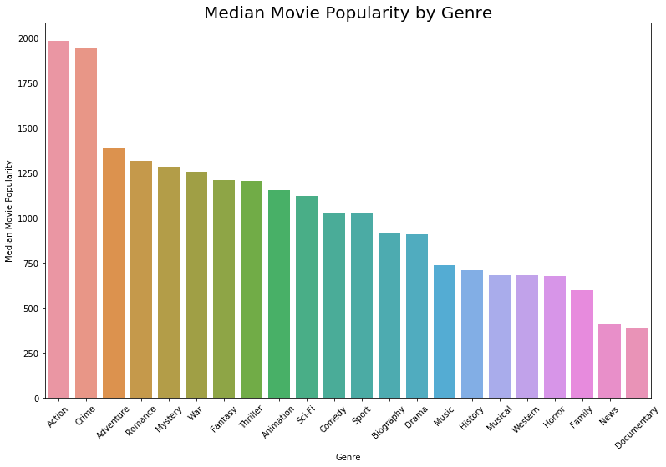
Results: Genres with highest median popularity
action
Crime
adventure
Notes:
I looked at the median popularity for movies made in each genre, and found that action, crime, and adventure are the top three genres. This metric is mainly based on the number of people who rated the movies – the actual average rating doesn’t change that much between the genres

Slide 7
Results: longer runtime correlated with increased ratings and popularity
For Action movies...
Notes:
Then looked at each of the top 3 genres to see if length of the movie is correlated with popularity and average rating
Popularity on the left, average rating on the right
Both have positive correlation
Rating has stronger positive correlation, meaning users do appreciate longer movies

Slide 8
Results: longer runtime correlated with increased ratings and popularity
And Crime movies…

Slide 9
Results: longer runtime correlated with increased ratings and popularity
And Adventure movies!

Slide 10
Results: longer runtime correlated with increased ratings and popularity
Median Length of Movies by Popularity and Genre
Popular Movies:
Movies in the top 25% of Popularity (Average Ratings x Number of Ratings)
Unpopular Movies:
Movies in the lower 75% of Popularity
Genre | Popular Movies | Unpopular Movies
Action | 110 min | 97 min
Crime | 106 min | 95 min
Adventure | 105 min | 90 min
Notes:
Microsoft should aim for the runtimes in this chart which are the three runtimes in the top genres

Slide 11
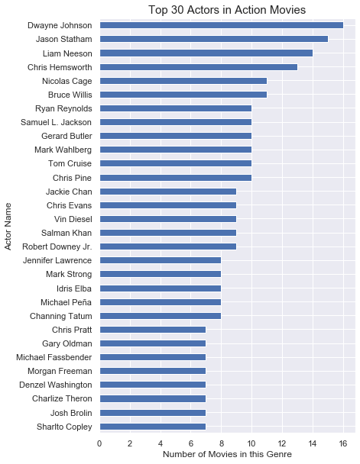
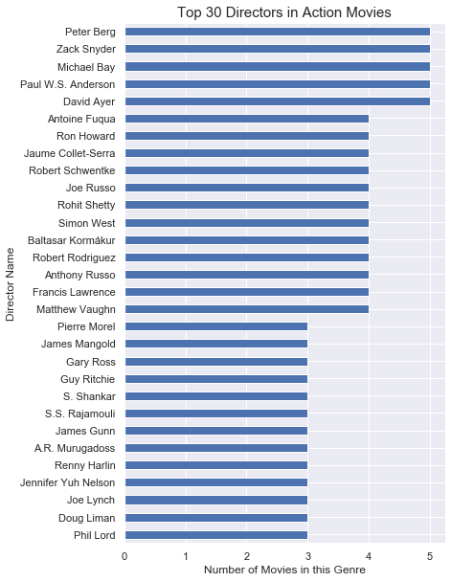
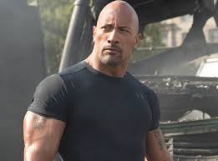
Results: top actors and directors in action movies
This analysis looks at only the top 5% of all movies by Popularity
Which actors and directors have racked up the most credits in this exclusive category, by genre?
Notes:
With the third question, tried to help Microsoft find actors and directors associated with top movies
Top movies is movies in the top 5% of popularity, 95th percentile and above
I looked at the 3 top genres within just the top 5% of movies and saw which actors and directors showed up the most
Did include male and female actors, though heavy hitters seem to be male

Slide 12
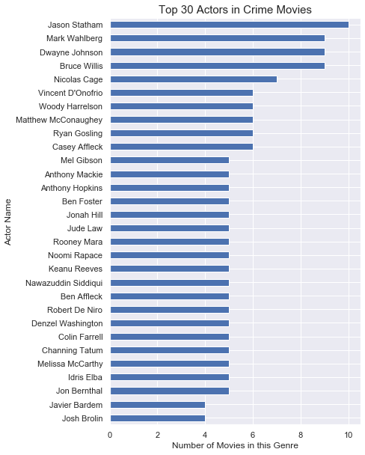
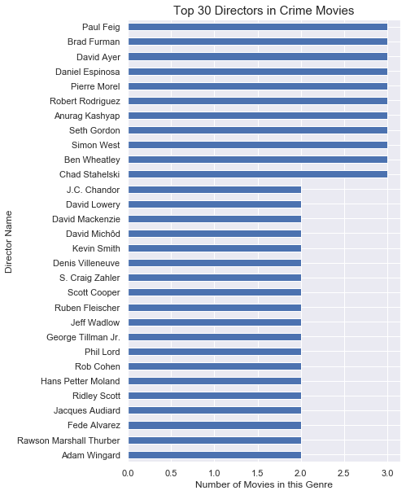
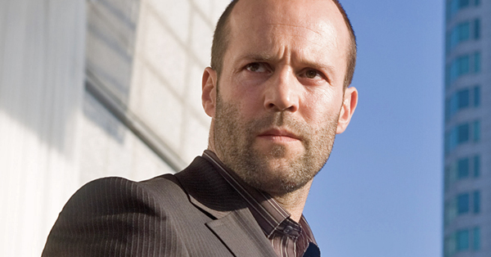
Results: top actors and directors in Crime movies
For Crime movie stars and directors, there is some overlap with Action heavy hitters, especially among actors
In this genre, no director has made more than three movies

Slide 13
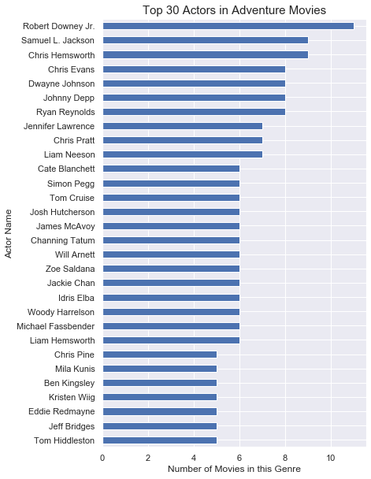
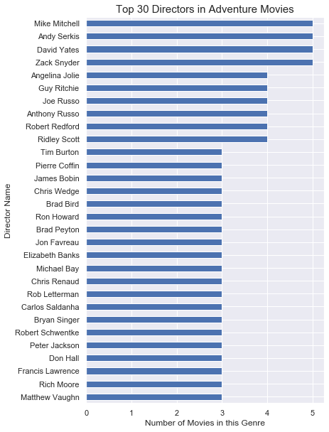

Results: top actors and directors in Adventure movies
Recruiting iconic actors who have a proven track record of making blockbusters will help grow Microsoft’s brand

Slide 14
Conclusions
Further Investigation
To successfully break into the streaming movie business, Microsoft should focus on Action, Crime, and Adventure movies
Microsoft should make movies that are around 105-110 minutes long
Microsoft should recruit actors and directors from the “Top 30” lists, heavy hitters who can draw a large audience
A budget analysis by genre would help Microsoft predict its return on investment
It is possible that the most popular genres are also the most expensive
By going down a few notches to Romance or Mystery, could Microsoft achieve greater profitability?
Notes:
Further investigation: look at budget. Maybe the top genres are also the most expensive – need to look at ROI

Slide 15
Thank You!
Email: lilisbeit@gmail.com
GitHub: @lilisbeit
LinkedIn: linkedin.com/in/lili-beit-33bb823/

